Slide 1
Python for Data
>>> import pandas as pd
MODULE 9
NumPy for numbers, Pandas for tables, Matplotlib for charts
Noorjahan · ASAP / AIML Batch 5
Notes:
This is the bridge into the ML course. Everything from Modules 1–8 comes together here: lists become arrays, dictionaries become DataFrames, functions get applied to whole columns. Prepare students.csv with columns name, marks, city and hours, about 10–15 rows, including one missing value.

Slide 2
What we'll cover
TODAY
01
NumPy arrays: creating, shaping, indexing
02
Fast maths and statistics on whole arrays
03
Pandas: loading and exploring a CSV
04
Selecting, filtering, grouping and cleaning data
05
Charts with Matplotlib
Python Fundamentals · Module 9
02
Notes:
Best over three sessions: NumPy (slides 3–8), Pandas (slides 9–15), Matplotlib and the mini analysis (slides 16–20). Colab is ideal here because all three libraries are preinstalled.

Slide 3
Objects from Module 8
QUICK RECAP
A class is a blueprint; objects are built from it
self is the object a method is working on
Child classes inherit and can override
Today's libraries are all classes and methods
# Quick check: what prints?
class Dog:
def __init__(self, name):
self.name = name
def speak(self):
return self.name + " says woof"
print(Dog("Bruno").speak())
Python Fundamentals · Module 9
03
Notes:
Answer: Bruno says woof. Point out that a NumPy array and a Pandas DataFrame are objects too: df.head() is a method call and df.shape is an attribute, exactly like Module 8.

Slide 4

Three libraries, one workflow
THE DATA STACK
import numpy as np
import pandas as pd
import matplotlib.pyplot as plt
NumPy
Pandas
Tables with labelled rows and columns
Matplotlib
Fast arrays of numbers
Charts and plots
Load → explore → clean → visualise. The same steps start every machine learning project.
Python Fundamentals · Module 9
04
Notes:
Pandas is built on top of NumPy, and Matplotlib draws NumPy arrays and Pandas columns. scikit-learn then takes NumPy arrays or DataFrames as input. Always use the standard aliases np, pd and plt: every tutorial and Stack Overflow answer assumes them.

Slide 5
Lists vs NumPy arrays
NUMPY
Python list
NumPy array
marks = [78, 92, 65]
marks * 2
# [78, 92, 65, 78, 92, 65]
# repeats the list!
marks = np.array([78, 92, 65])
marks * 2
# array([156, 184, 130])
# maths on every item
No loops needed
Much faster
Many dimensions
Write maths for the whole array
Runs in optimised C code
Tables, images and more
Python Fundamentals · Module 9
05
Notes:
Start with import numpy as np. The list * 2 result surprises everyone, so demo it first. "Vectorised" is the word for doing maths on a whole array at once. All items in an array share one type, which is part of why it's fast. For a speed demo, compare a for loop with np.sum on a million numbers using %timeit in Jupyter.

Slide 6
Ways to make an array
NUMPY · CREATING ARRAYS
CODE | RESULT | USE IT FOR
np.array([1, 2, 3]) | [1 2 3] | From a list
np.zeros(3) | [0. 0. 0.] | A blank starting point
np.ones((2, 3)) | 2 rows × 3 columns of 1. | A grid of ones
np.arange(0, 10, 2) | [0 2 4 6 8] | Like range(), but an array
np.linspace(0, 1, 5) | [0. 0.25 0.5 0.75 1.] | Evenly spaced points
np.random.randint(0, 101, 5) | e.g. [42 87 13 66 95] | Random test data
Python Fundamentals · Module 9
06
Notes:
The dot after numbers (0., 1.) means they're floats. np.ones takes a tuple for the shape, hence the double brackets. Like random.randint in Module 7 but with one difference: NumPy's upper limit is excluded, the same as range(), so 0–100 needs randint(0, 101).

Slide 7
2D arrays: rows and columns
NUMPY · SHAPE AND INDEXING
m = np.array([[1, 2, 3],
[4, 5, 6]])
CODE | RESULT
m.shape | (2, 3)
m.ndim | 2
m[1, 2] | 6
m[0] | [1 2 3]
m[:, 0] | [1 4]
m.reshape(3, 2) | 3 rows, 2 columns
col 0
col 1
col 2
1
2
3
row 0
4
5
6
row 1
Python Fundamentals · Module 9
07
Notes:
m[1, 2] reads "row 1, column 2" (the highlighted 6). It's like grid[1][2] from Module 4, but with one pair of brackets. The colon in m[:, 0] means "all rows". shape is an attribute (no brackets) and returns a tuple. In ML, data is usually a 2D array: rows are samples, columns are features. An image is a 3D array: height × width × colour channels.

Slide 8
Whole-array maths, stats and filters
NUMPY · MATHS AND STATISTICS
marks = np.array([78, 92, 65, 88])
MATHS AND STATS | RESULT
marks + 5 | [83 97 70 93]
marks.mean() | 80.75
marks.max() | 92
marks.std() | 10.43 (rounded)
FILTERING (BOOLEAN MASKS) | RESULT
marks > 80 | [F T F T]
marks[marks > 80] | [92 88]
(marks >= 40).sum() | 4
marks.argmax() | 1
Python Fundamentals · Module 9
08
Notes:
[F T F T] is shorthand on the slide; the real output is array([False, True, False, True]). Putting that mask inside square brackets keeps only the True positions: this "boolean mask" idea is exactly how Pandas filtering works on the next slides. Summing booleans counts the Trues. argmax gives the position of the highest value, which is how a classifier picks its predicted class.

Slide 9
A DataFrame is a spreadsheet in Python
PANDAS
 | name | marks | city
0 | Asha | 88 | Kochi
1 | Rahul | 72 | Thrissur
2 | Meera | 95 | Kozhikode
Columns
Each has a name and holds one kind of data
Index
A label for each row (0, 1, 2 by default)
Series
A single column on its own
Python Fundamentals · Module 9
09
Notes:
Section break. If students know Excel, lean on that: columns have headers, rows are records. The difference is that everything is done in code, so it's repeatable and works on millions of rows. Each column is a NumPy array underneath, so all of the NumPy maths still works.

Slide 10
Making a DataFrame from a dictionary
PANDAS · CREATING
import pandas as pd
df = pd.DataFrame({
"name": ["Asha", "Rahul", "Meera"],
"marks": [88, 72, 95],
"city": ["Kochi", "Thrissur", "Kozhikode"],
})
df # shows the table
Keys become columns
Each list becomes that column's values
Same length
Every list needs the same number of items
Or a list of dicts
pd.DataFrame(students) works on the Module 4 list too
Python Fundamentals · Module 9
10
Notes:
This is how the table on the previous slide was made. In Jupyter or Colab, typing df on the last line of a cell shows a neat formatted table; print(df) shows a plain-text version. In practice you usually load data from a file rather than typing it, which is the next slide.

Slide 11
Load a CSV in one line, then look around
PANDAS · LOADING AND EXPLORING
df = pd.read_csv("students.csv")
CODE | SHOWS YOU
df.head() | The first 5 rows
df.shape | (rows, columns), e.g. (5, 4)
df.info() | Column types and how many values are missing
df.describe() | Count, mean, min, max and more for number columns
df.columns | The column names
df["city"].value_counts() | How many rows there are for each city
Python Fundamentals · Module 9
11
Notes:
Compare with Module 6, where reading a CSV took a with block, a loop and DictReader. Sample students.csv for these slides: name, marks, city, hours with Asha 88 Kochi 6, Rahul 72 Thrissur 4, Meera 95 Kozhikode 8, John 64 Kochi 3, Fatima 81 Thrissur 5. Always run head(), shape, info() and describe() first on any new dataset; it's the habit every data scientist has.

Slide 12
Picking out columns, rows and values
PANDAS · SELECTING
CODE | GIVES YOU
df["marks"] | One column, as a Series
df[["name", "marks"]] | Several columns, as a DataFrame (note the double brackets)
df.loc[0] | The row whose index label is 0
df.iloc[-1] | The row at position -1 (the last row)
df.loc[0, "name"] | One value: 'Asha'
df["marks"].mean() | The column's average: 80.0
Python Fundamentals · Module 9
12
Notes:
The mean of 88, 72, 95, 64 and 81 is 400 / 5 = 80.0. loc uses labels and iloc uses positions ("i" for integer). With the default 0, 1, 2 index they look the same; the difference shows after sorting or filtering. Selecting a column feels like dictionary lookup from Module 4: df["marks"] works like student["marks"].

Slide 13
Finding the rows you want
PANDAS · FILTERING AND SORTING
# one condition
df[df["marks"] > 80]
# two conditions: & for and, | for or
df[(df["marks"] > 70) & (df["city"] == "Kochi")]
# top 3 by marks
df.sort_values("marks", ascending=False).head(3)
df[df["marks"] > 80]
 | name | marks
0 | Asha | 88
2 | Meera | 95
4 | Fatima | 81
Same boolean-mask idea as NumPy. The index labels stay with their rows.
Python Fundamentals · Module 9
13
Notes:
The two-condition filter returns just Asha (Kochi, 88); John is also from Kochi but has 64. The sort gives Meera, Asha, Fatima. Two classic errors: using the words and/or instead of & and |, and forgetting the round brackets around each condition. df.nlargest(3, "marks") is a shortcut for the top-3 line.

Slide 14
Adding columns and summarising groups
PANDAS · NEW COLUMNS AND GROUPS
New columns
Group and summarise
# from a calculation
df["passed"] = df["marks"] >= 40
# from your own function
# (grade() from Module 5)
df["grade"] = df["marks"].apply(grade)
df.groupby("city")["marks"].mean()
city
Kochi 76.0
Kozhikode 95.0
Thrissur 76.5
apply() runs a function on every value in the column.
Split by city, average each group, combine the results.
Python Fundamentals · Module 9
14
Notes:
Using the 5-student sample: Kochi is Asha 88 and John 64, so 76.0; Thrissur is Rahul 72 and Fatima 81, so 76.5; Kozhikode is Meera alone, 95.0. Swap .mean() for .count(), .max() or .sum(). groupby is the Pandas version of the Module 4 counting-by-dictionary pattern, done in one line. With the Module 5 grade(), the grade column reads Distinction, Pass, Distinction, Pass, Distinction.

Slide 15
Real data is messy: cleaning it up
PANDAS · CLEANING
CODE | WHAT IT DOES
df.isna().sum() | Count missing values in each column
df = df.dropna() | Remove rows with missing values
df["marks"] = df["marks"].fillna(0) | Fill gaps with a value instead
df = df.drop_duplicates() | Remove repeated rows
df = df.rename(columns={"marks": "score"}) | Rename a column
df["marks"] = df["marks"].astype(int) | Change a column's type
df.to_csv("clean.csv", index=False) | Save the cleaned data
Most methods return a new DataFrame, so assign the result back: df = df.dropna()
Python Fundamentals · Module 9
15
Notes:
Missing values show as NaN ("not a number"). A common alternative fill is the column average: df["marks"].fillna(df["marks"].mean()). Whether to drop or fill depends on the data and is a real decision in ML projects. Forgetting to assign the result back is the most common Pandas bug: df.dropna() alone shows a cleaned copy but leaves df unchanged. It's the same idea as string methods in Module 4.

Slide 16
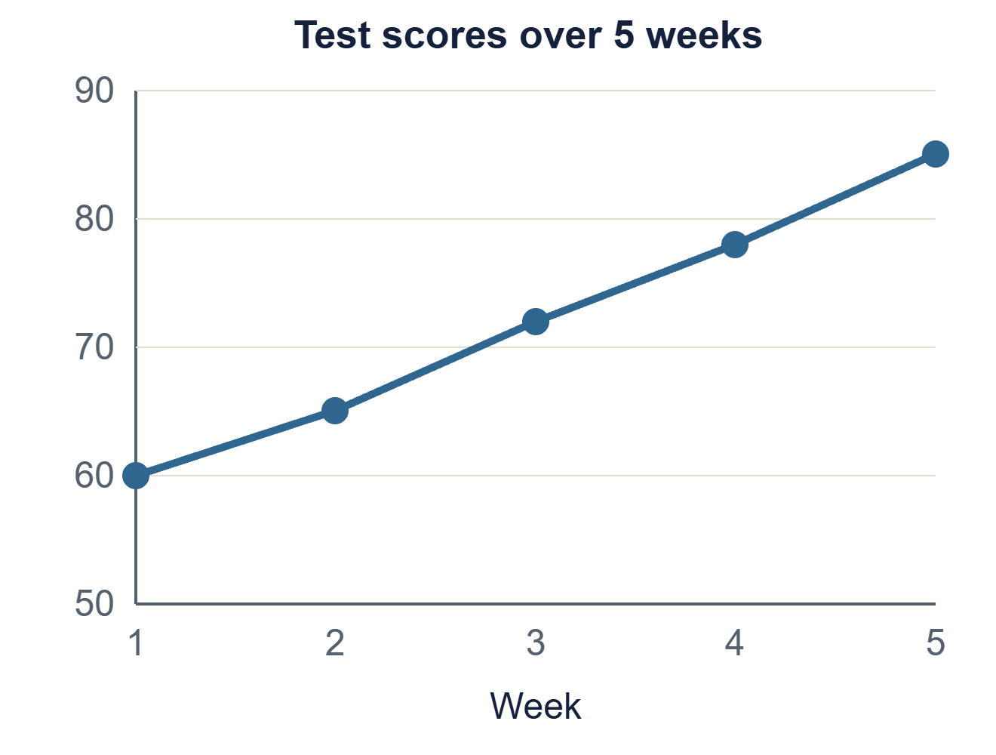
Your first chart
MATPLOTLIB
import matplotlib.pyplot as plt
weeks = [1, 2, 3, 4, 5]
scores = [60, 65, 72, 78, 85]
plt.plot(weeks, scores, marker="o")
plt.title("Test scores over 5 weeks")
plt.xlabel("Week")
plt.ylabel("Score")
plt.show()
Python Fundamentals · Module 9
16
Notes:
The picture on the right is roughly what this code draws (Matplotlib's default style looks a little different). The pattern is always: prepare data, call a plot function, add a title and labels, then show. In Jupyter and Colab the chart appears below the cell; plt.show() is still good practice. Try changing marker="o" to "s" or adding color="orange".

Slide 17
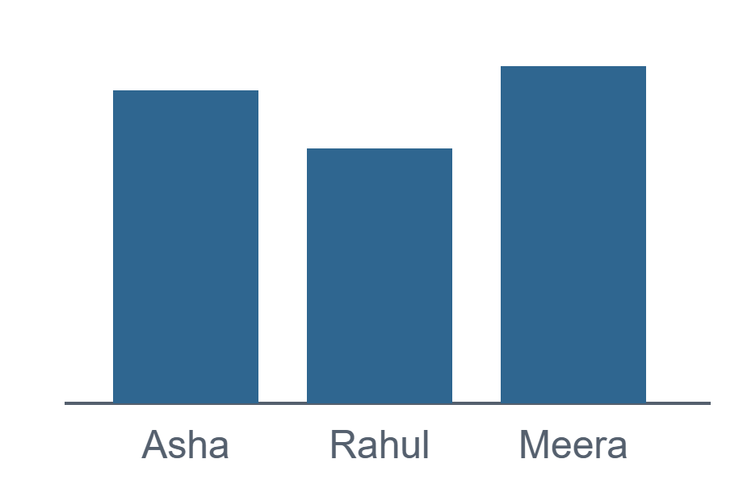
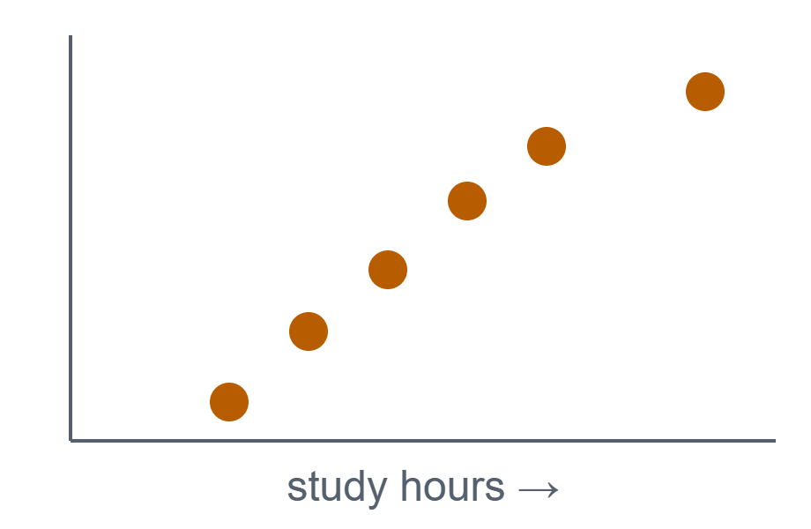
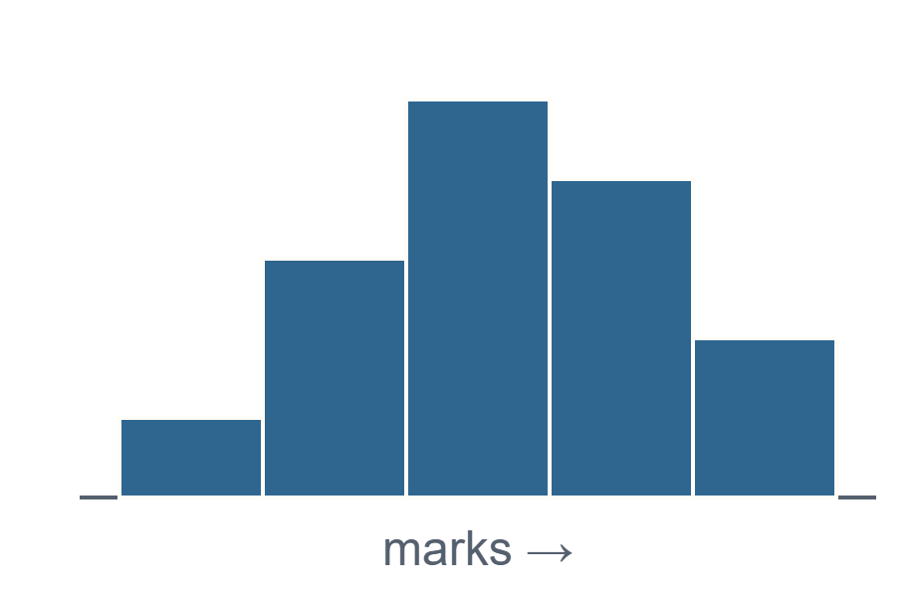
Pick the chart that fits the question
MATPLOTLIB · CHART TYPES
Bar: compare groups
Scatter: find relationships
Histogram: see the spread
plt.bar(names, marks)
plt.scatter(hours, marks)
plt.hist(marks, bins=5)
Python Fundamentals · Module 9
17
Notes:
Ask the question first, then choose the chart: "who scored highest?" is a bar chart; "do more study hours mean higher marks?" is a scatter; "how are marks spread across the class?" is a histogram. Line charts (previous slide) are for change over time. Scatter plots are the first thing to draw before any regression model in the ML course.

Slide 18
Plotting straight from a DataFrame
MATPLOTLIB · FROM PANDAS
df.plot(x="name", y="marks", kind="bar")
df["marks"].plot(kind="hist", bins=5)
df.plot(x="hours", y="marks", kind="scatter")
# save before show()
plt.savefig("chart.png", dpi=150)
plt.show()
A good chart…
Has a title that says what it shows
Labels both axes, with units
Makes one point clearly
Is saved with savefig() to share
Python Fundamentals · Module 9
18
Notes:
df.plot() uses Matplotlib behind the scenes, so plt.title() and plt.ylabel() still work afterwards. savefig must come before plt.show(), because show() clears the figure; saving afterwards gives a blank image. dpi=150 gives a sharper image for reports and slides. plt.tight_layout() stops long labels getting cut off.

Slide 19
A complete mini analysis
PUTTING IT TOGETHER
import pandas as pd
import matplotlib.pyplot as plt
df = pd.read_csv("students.csv")
print(df.describe())
avg = df.groupby("city")["marks"].mean()
avg.plot(kind="bar", title="Average marks by city")
plt.ylabel("Marks")
plt.tight_layout()
plt.savefig("city_marks.png")
plt.show()
1
Load the CSV
2
Explore with describe()
3
Summarise with groupby
4
Visualise as a bar chart
5
Save the chart to share
Python Fundamentals · Module 9
19
Notes:
Twelve lines take you from a raw file to a saved chart. Compare with the Module 6 version of reading this same CSV by hand. Run it live and open city_marks.png afterwards. Extensions: add a cleaning step (dropna) between load and explore, or a second chart of hours vs marks.

Slide 20
Your turn
PRACTICE
Make a NumPy array of 20 random marks; print the mean, max and how many passed
Load students.csv and show the top 3 students by marks
Add a grade column using apply() and your Module 5 grade()
Find the average marks per city with groupby
Plot hours vs marks as a scatter chart and save it as a PNG
NEXT UP
Mini-projects
Marks analyzer, to-do app, bank system and a CSV analysis, using everything from Modules 1–9
Python Fundamentals · Module 9
20
Notes:
Give 30–40 minutes. (1) m = np.random.randint(0, 101, 20); then m.mean(), m.max(), (m >= 40).sum(). (2) df.sort_values("marks", ascending=False).head(3) or df.nlargest(3, "marks"). (3) Paste grade() into a cell first. (4) df.groupby("city")["marks"].mean(). (5) df.plot(x="hours", y="marks", kind="scatter"), then plt.savefig() before plt.show().

